Slide 1
Machine Learning to extract spectral information from Graphene/Quantum Dot multilayer devices

Slide 2
Goal: Infer/Extract light spectra using thin film photodetectors

Slide 3
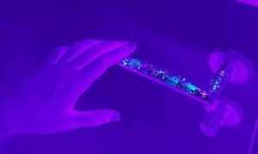
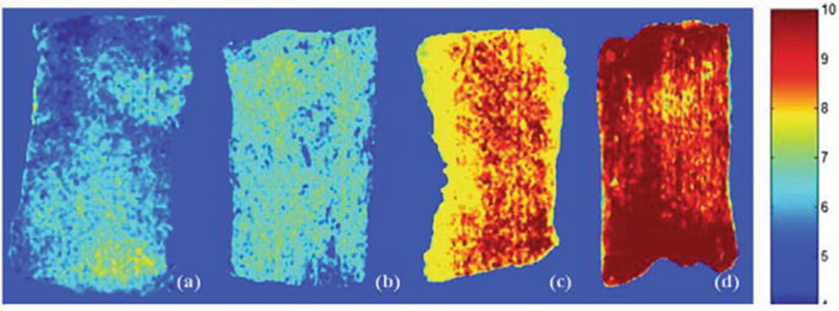
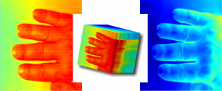
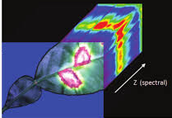
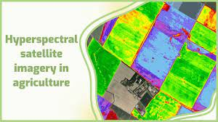
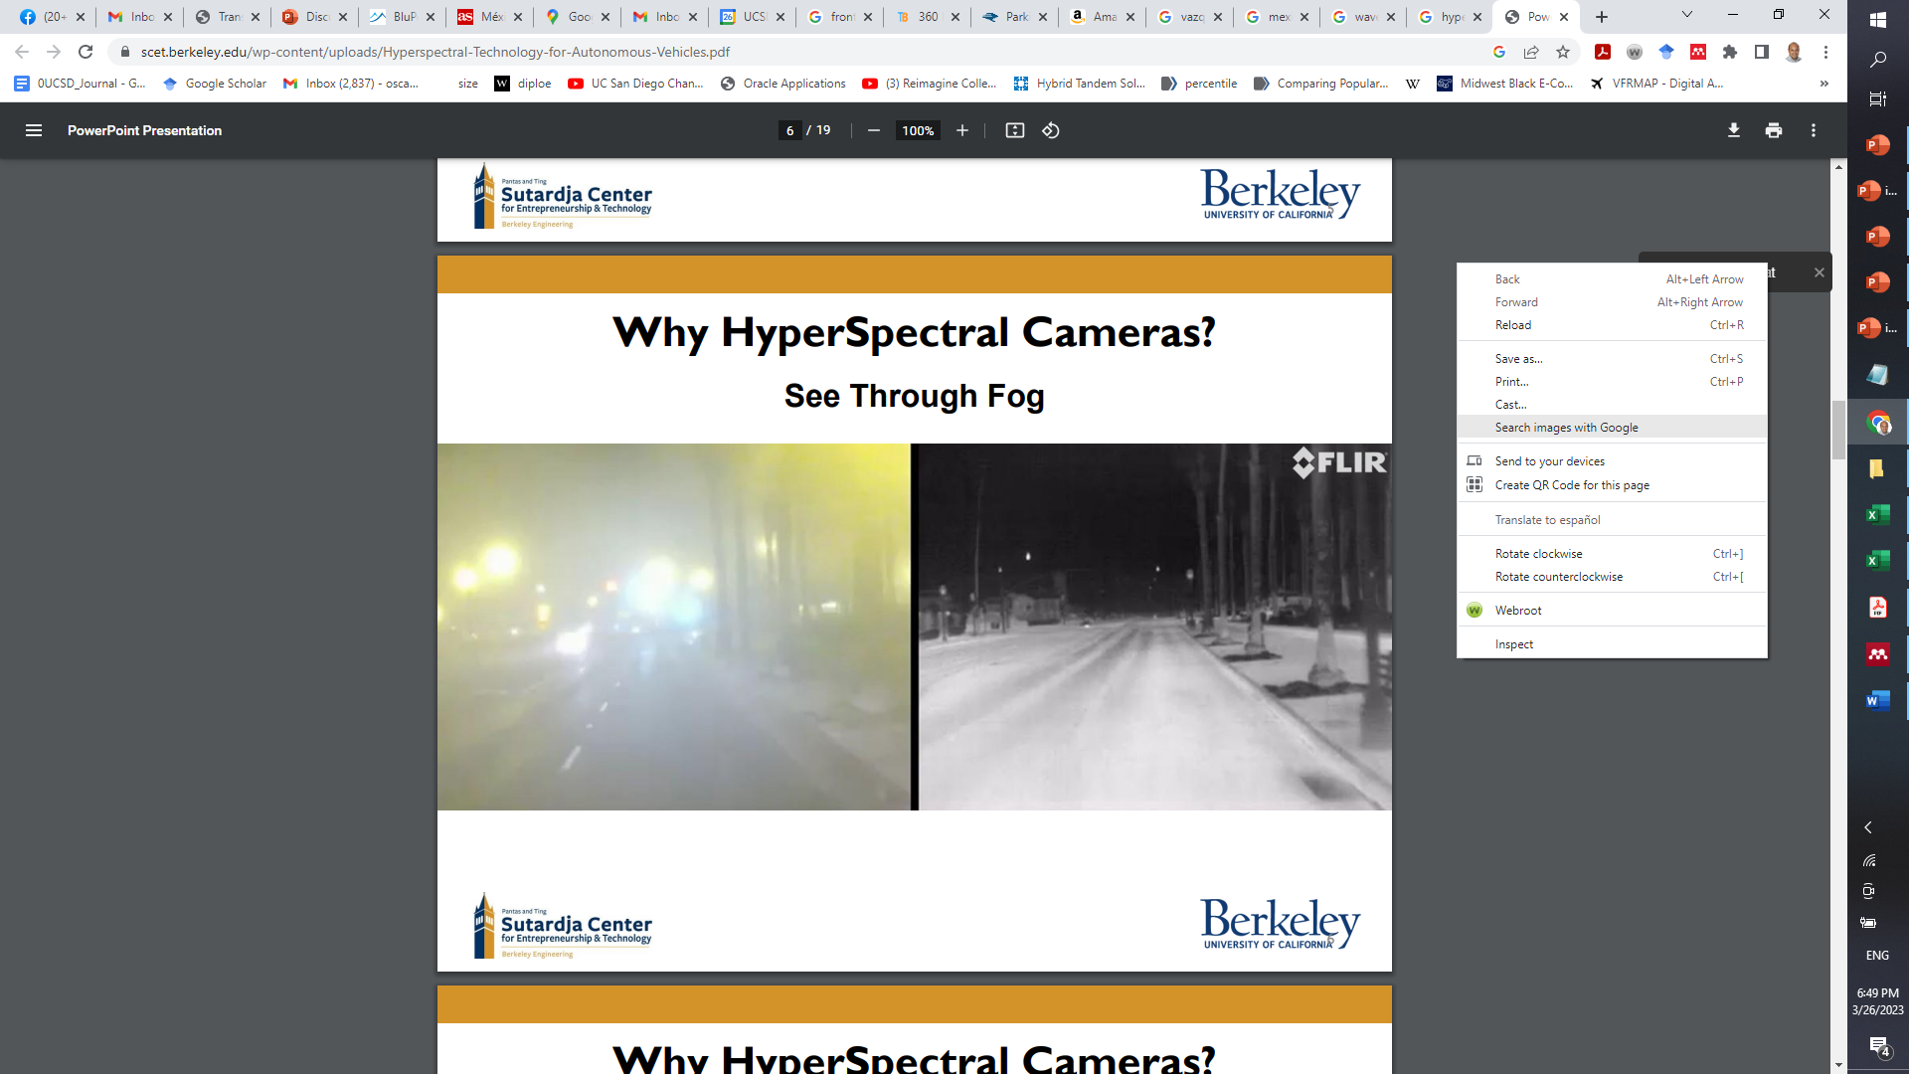
Motivation: Multispectral imaging provides critical information for health care, material identification, encryption
Surface Biocontamination by multispectral imaging
Multispectral imaging shows Escherichia coli contamination in fish fillets
Autonomous driving through fog

Slide 4
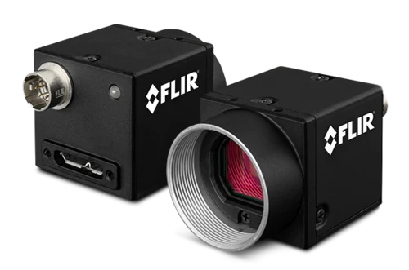
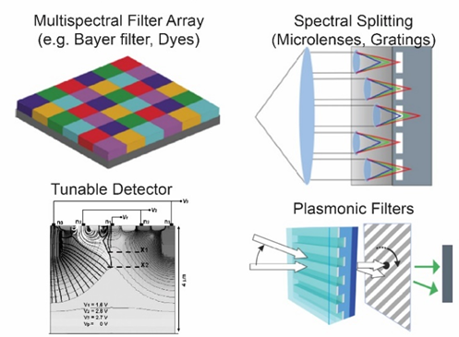
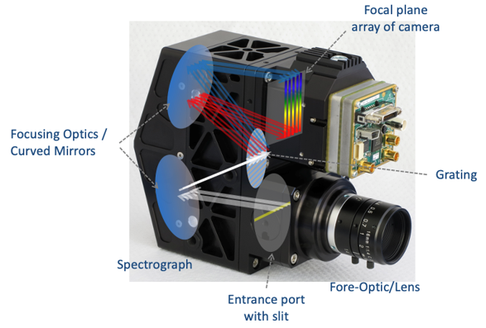
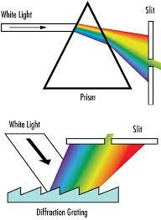
Current technologies are bulky: Diffractive elements, long optical paths, multiple lenses

Slide 5
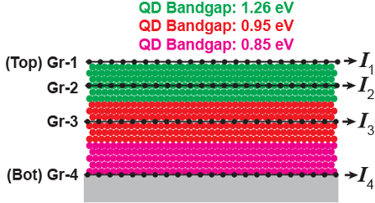
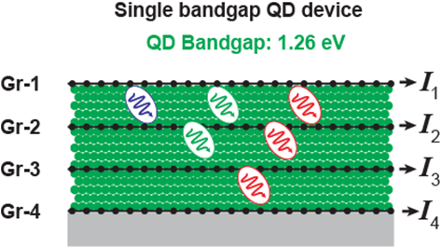
Our goal: Produce a thin film multispectral photodetector able to extract wavelength/spectral information (This devices are around 500 nm to 1 um thick)
Key is to read the photocurrent for each graphene.
Longer wavelength penetrate deeper and are mainly detected at the bottom, while top layers are more sensible to short wavelengths.
Or, introduce different QDs with different absorption spectrum.

Slide 6
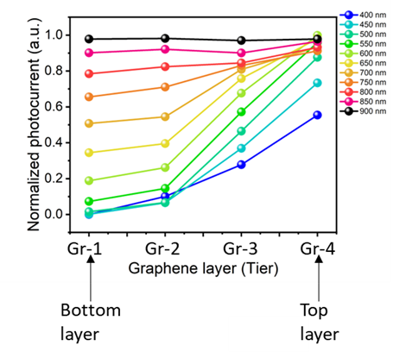
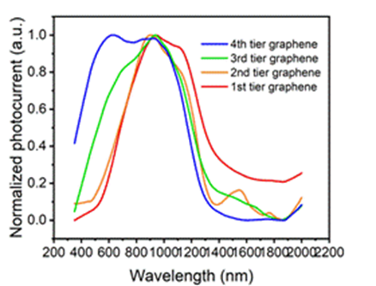
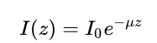
Normalized photocurrent
Gr-1
Gr-2
Gr-3
Gr-4
Gr-1
Gr-2
Gr-3
Gr-4
Gr-1
Gr-2
Gr-3
Gr-4
Short wavelengths decay rapidly through the layer
Long wavelength decay slowly through the layer
μ: Absorption coefficient wavelength dependent.
High for short λ, Low for long λ

Slide 7
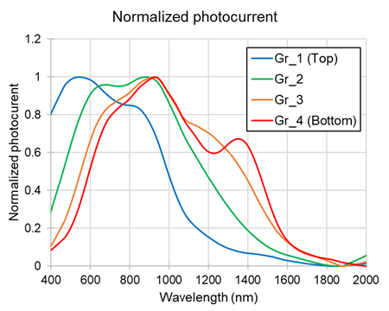
Even though there is a clear shift in spectral response, there is a lot of overlap between the response of each graphene layer.
Question: Can we use some machine learning algorithms to re-build a certain spectrum based on the collective response of the graphene layers??

Slide 8
Intercalated Gr/QD/SiO₂ Devices as a Photospectrometer
Unknown Spectrum
I
–
+
+
Insulating Oxide
Au
QDs
Au
P
I
–
+
+
λ

Slide 9
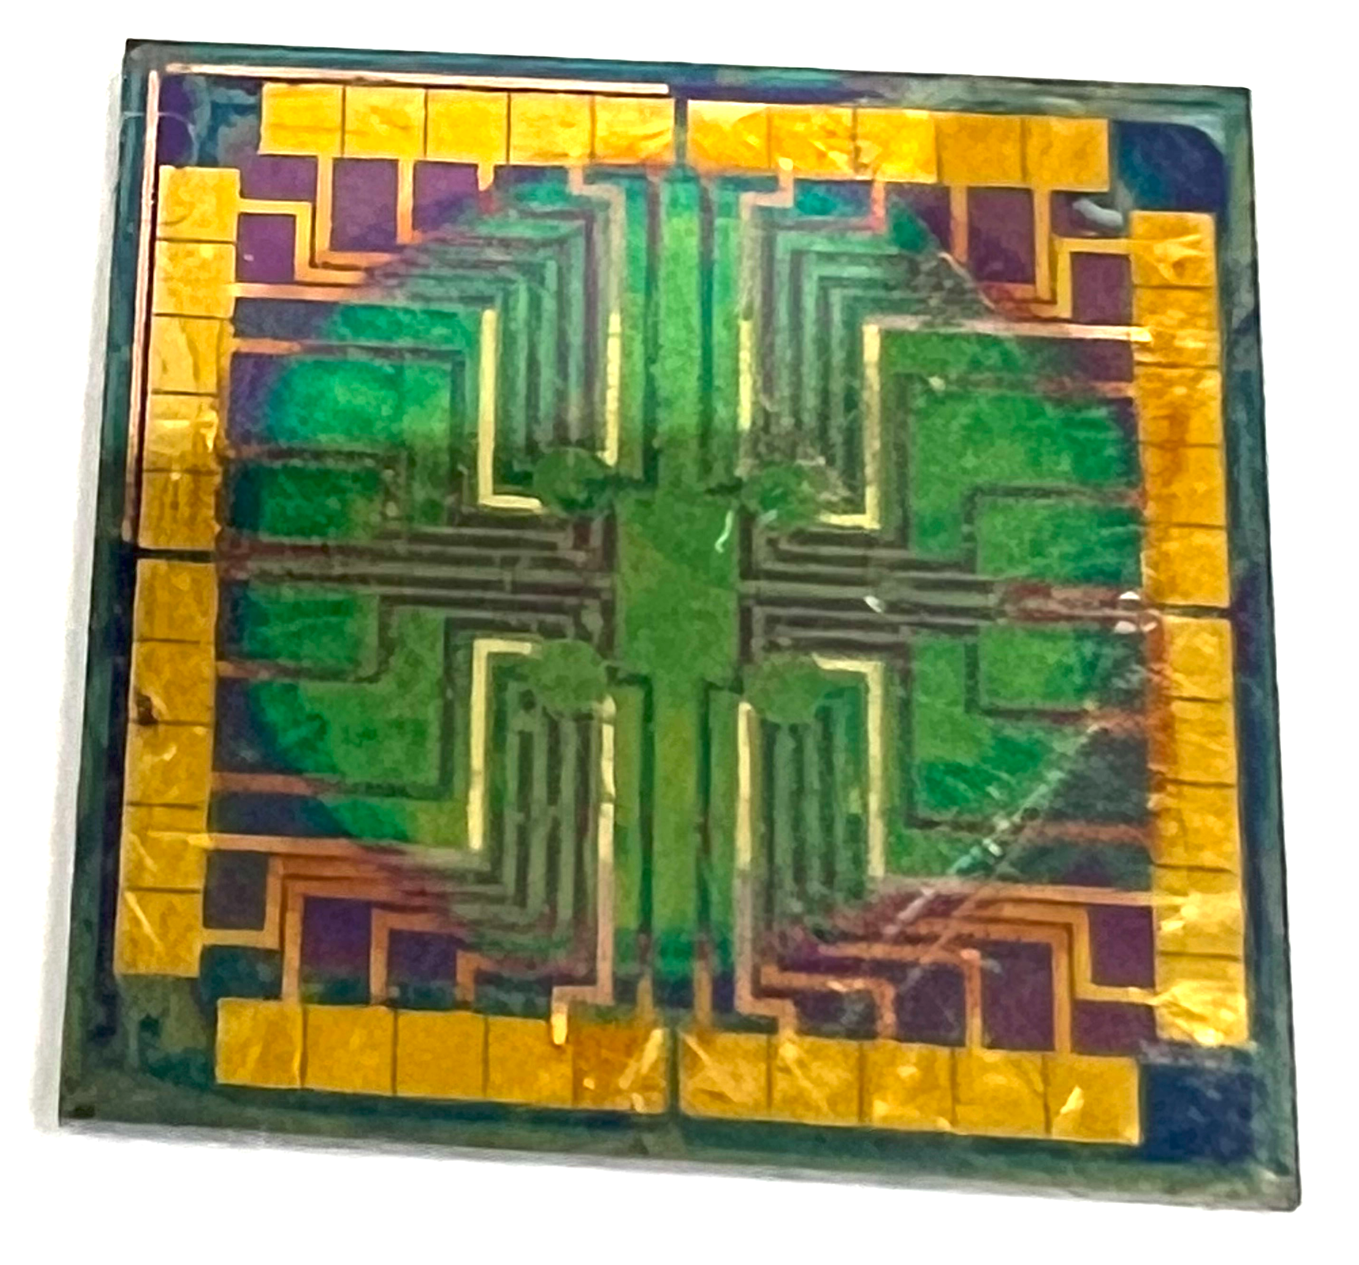
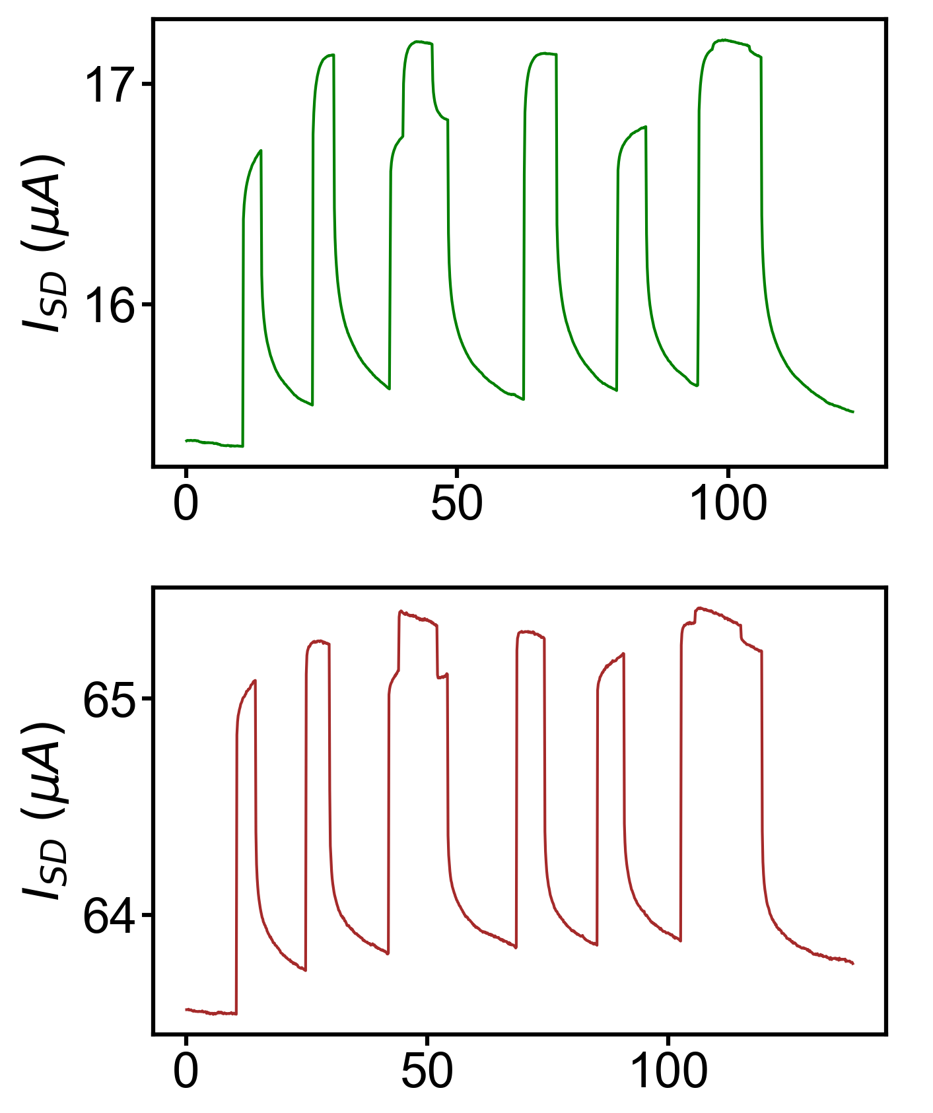
Challenge: How do we identify the wavelengths and power intensities of the unknown spectrum?
Photocurrent Response to Red and Blue Lasers
Red+Blue
Blue+Red
Blue
Blue
Red
Red
Au
Au
2nd Gr
Sputtered SiO₂
1st Gr
2nd Gr
Photograph of the Intercalated Gr/QD/SiO₂ Device
We need to use Machine Learning Models to train and predict the spectrum of the incident light
1st Gr
Time (s)

Slide 10
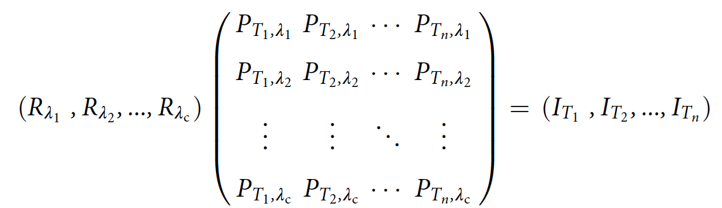
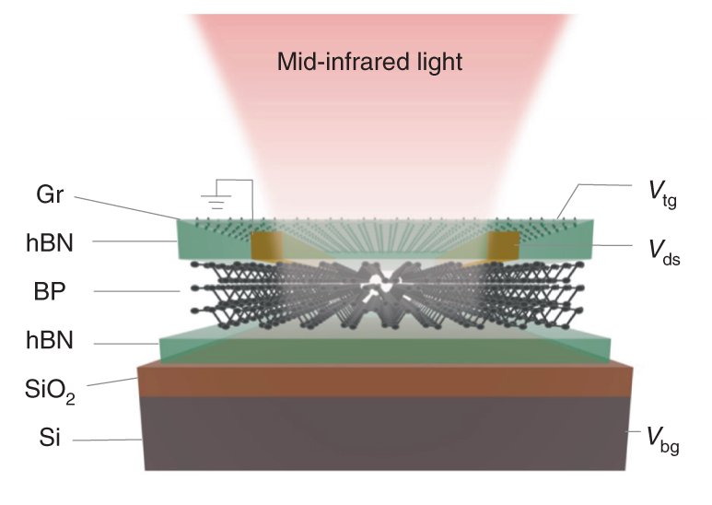
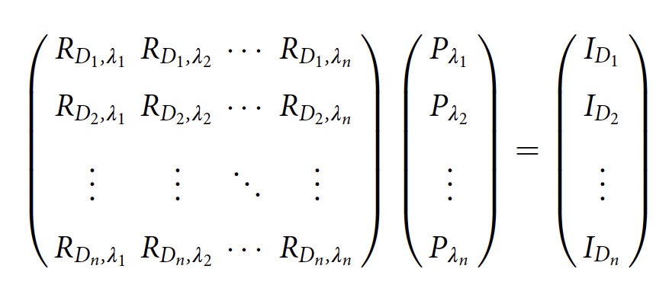
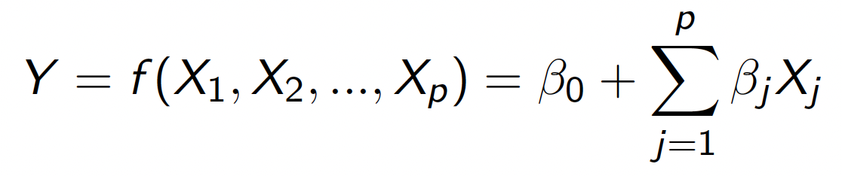
In Literature: A Black Phosphorus Device with Linear Regression Models
Step 1: Find the responsivity at one displacement field
Used Ridge Regression
Coefficients β_{j}
X
y
Step 2: Generate the Responsivity Matrix
Generated the Responsivity Matrix (left) by repeating the above process at different displacement fields (combination of bottom and top gate fields)
Benefits of using Linear Regression:
The coefficients for the training set can be extracted and combined into a new matrix
Different light sources are included in the training set as features
Linear regression:
Step 3: Reconstruct the Unknown Spectrum
Used LASSO and Ridge regression to reconstruct the unknown spectra
Nature Photonics, 15, 601–607 (2021)
X
Coefficients β_{j}
y

Slide 11
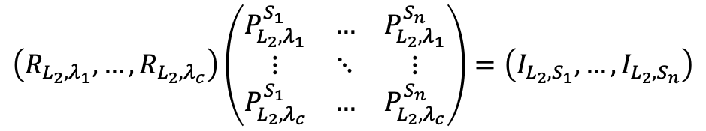
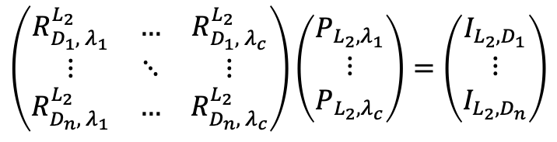
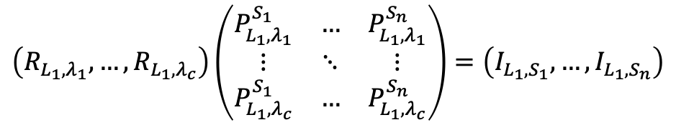
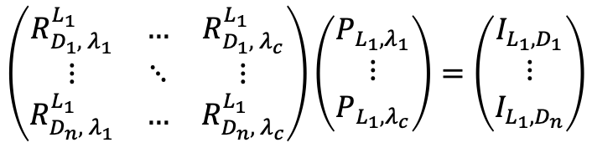
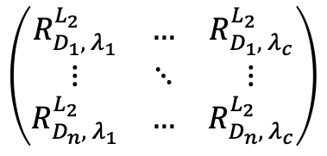
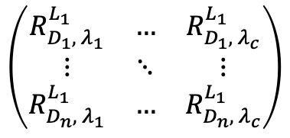
Adapting the literature’s Linear Regression Models to our devices
Step 1: Find the responsivity at one displacement field for both layers
Au
Au
2nd Gr
$$\left(R_{{L_{1},λ}_{1}}, …,R_{{L_{1},λ}_{c}}\right)\left(\begin{matrix}P_{L_{1}, λ_{1}}^{S_{1}} & … & P_{L_{1}, λ_{1}}^{S_{n}} \\ ⋮ & ⋱ & ⋮ \\ P_{L_{1}, λ_{c}}^{S_{1}} & … & P_{L_{1}, λ_{c}}^{S_{n}}\end{matrix}\right)=\left(I_{{L_{1},S}_{1}},…,I_{{L_{1},S}_{n}}\right)$$
Sputtered SiO₂
1st Gr
$$\left(R_{{L_{2},λ}_{1}}, …,R_{{L_{2},λ}_{c}}\right)\left(\begin{matrix}P_{L_{2}, λ_{1}}^{S_{1}} & … & P_{L_{2}, λ_{1}}^{S_{n}} \\ ⋮ & ⋱ & ⋮ \\ P_{L_{2}, λ_{c}}^{S_{1}} & … & P_{L_{2}, λ_{c}}^{S_{n}}\end{matrix}\right)=\left(I_{{L_{2},S}_{1}},…,I_{{L_{2},S}_{n}}\right)$$
We have two layers, which means we have two sets of photocurrents
Step 2: Generate the Responsivity Matrix for both layers
Step 3: Reconstruct the Unknown Spectrum using both layers
$$\left(\begin{matrix}R_{D_{1}, λ_{1}}^{L_{1}} & … & R_{D_{1}, λ_{c}}^{L_{1}} \\ ⋮ & ⋱ & ⋮ \\ R_{D_{n}, λ_{1}}^{L_{1}} & … & R_{D_{n}, λ_{c}}^{L_{1}}\end{matrix}\right)$$
$$\left(\begin{matrix}R_{D_{1}, λ_{1}}^{L_{2}} & … & R_{D_{1}, λ_{c}}^{L_{2}} \\ ⋮ & ⋱ & ⋮ \\ R_{D_{n}, λ_{1}}^{L_{2}} & … & R_{D_{n}, λ_{c}}^{L_{2}}\end{matrix}\right)$$
$$\left(\begin{matrix}R_{D_{1}, λ_{1}}^{L_{1}} & … & R_{D_{1}, λ_{c}}^{L_{1}} \\ ⋮ & ⋱ & ⋮ \\ R_{D_{n}, λ_{1}}^{L_{1}} & … & R_{D_{n}, λ_{c}}^{L_{1}}\end{matrix}\right)\left(\begin{matrix}P_{L_{1},λ_{1}} \\ ⋮ \\ P_{{L_{1},λ}_{c}}\end{matrix}\right)=\left(\begin{matrix}I_{{L_{1},D}_{1}} \\ ⋮ \\ I_{{L_{1},D}_{n}}\end{matrix}\right)$$
and
and
Step 4: Combine the two reconstructed spectra using ML
$$\left(\begin{matrix}R_{D_{1}, λ_{1}}^{L_{2}} & … & R_{D_{1}, λ_{c}}^{L_{2}} \\ ⋮ & ⋱ & ⋮ \\ R_{D_{n}, λ_{1}}^{L_{2}} & … & R_{D_{n}, λ_{c}}^{L_{2}}\end{matrix}\right)\left(\begin{matrix}P_{L_{2},λ_{1}} \\ ⋮ \\ P_{{L_{2},λ}_{c}}\end{matrix}\right)=\left(\begin{matrix}I_{{L_{2},D}_{1}} \\ ⋮ \\ I_{{L_{2},D}_{n}}\end{matrix}\right)$$

Slide 12
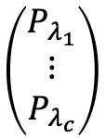
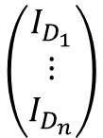
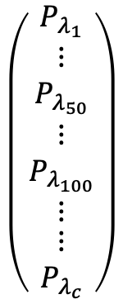
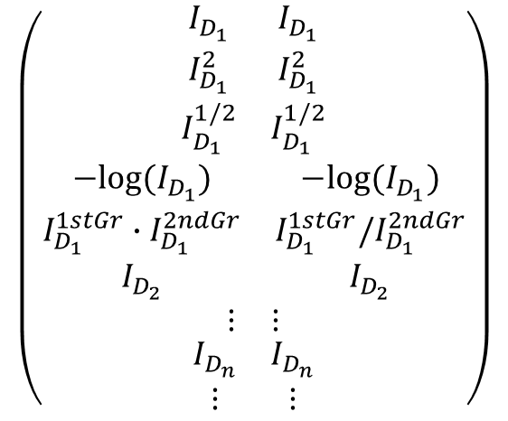
Other Machine Learning Models (Tree-based or Neural Network)
X
Machine Learning Model
y
X
Machine Learning Model
y
$$\left(\begin{matrix}I_{D_{1}} \\ ⋮ \\ I_{D_{n}}\end{matrix}\right)$$
$$\left(\begin{matrix}P_{λ_{1}} \\ ⋮ \\ P_{λ_{c}}\end{matrix}\right)$$
1st Gr
2nd Gr
$$\left(\begin{aligned}\begin{aligned}\begin{matrix}I_{D_{1}} & I_{D_{1}} \\ I_{D_{1}}^{2} & I_{D_{1}}^{2} \\ I_{D_{1}}^{1/2} & I_{D_{1}}^{1/2}\end{matrix} \\ \begin{matrix}−log⁡(I_{D_{1}}) & −log⁡(I_{D_{1}}) \\ I_{D_{1}}^{1stGr}∙I_{D_{1}}^{2ndGr} & I_{D_{1}}^{1stGr}/I_{D_{1}}^{2ndGr} \\ I_{D_{2}} & I_{D_{2}}\end{matrix}\end{aligned} \\ \begin{matrix}⋮ & ⋮\end{matrix} \\ \begin{matrix}I_{D_{n}} & I_{D_{n}} \\ ⋮ & ⋮\end{matrix}\end{aligned}\right)$$
$$\left(\begin{aligned}\begin{matrix}P_{λ_{1}} \\ ⋮ \\ P_{λ_{50}}\end{matrix} \\ \begin{matrix}⋮ \\ P_{λ_{100}} \\ ⋮\end{matrix} \\ \begin{matrix}⋮ \\ P_{λ_{c}}\end{matrix}\end{aligned}\right)$$
photocurrent measured at different gate voltages
power intensity at each wavelengths
Problem 1: Not the same length
Solution: Add transformations of the photocurrent
photocurrent measured at different gate voltages + transformations of photocurrent
power intensity at different wavelengths

Slide 13
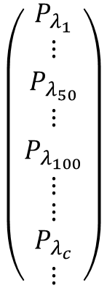
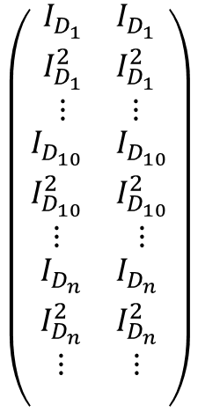
Other Machine Learning Models (Tree-based or Neural Network)
Machine Learning Model
X
y
1st Gr
2nd Gr
Problem 2: How do we add more light sources in the training set?
$$\left(\begin{aligned}\begin{aligned}\begin{matrix}I_{D_{1}} & I_{D_{1}} \\ I_{D_{1}}^{2} & I_{D_{1}}^{2} \\ ⋮ & ⋮\end{matrix} \\ \begin{matrix}I_{D_{10}} & I_{D_{10}} \\ I_{D_{10}}^{2} & I_{D_{10}}^{2} \\ ⋮ & ⋮\end{matrix}\end{aligned} \\ \begin{matrix}I_{D_{n}} & I_{D_{n}} \\ I_{D_{n}}^{2} & I_{D_{n}}^{2} \\ ⋮ & ⋮\end{matrix} \\ \begin{matrix} & \end{matrix}\end{aligned}\right)$$
$$\left(\begin{aligned}\begin{matrix}P_{λ_{1}} \\ ⋮ \\ P_{λ_{50}}\end{matrix} \\ \begin{matrix}⋮ \\ P_{λ_{100}} \\ ⋮\end{matrix} \\ \begin{matrix}⋮ \\ \begin{aligned}P_{λ_{c}} \\ ⋮\end{aligned}\end{matrix}\end{aligned}\right)$$
Solution: Add more data to the X and y matrices
The next few slides:
I used Adaboost and MLP to reconstruct the unknown spectra
Training set:
Solar simulator
Test set:
LEDs in Red, Blue, and Violet (red + blue)
Below is for a second light source
photocurrent measured at different gate voltages + transformations of photocurrent
power intensity at different wavelengths

